Slide 1

Renewal Information 2018
Iceland Catastrophe Insurance

Slide 2

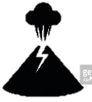


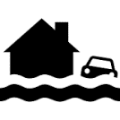





Iceland Catastrophe Insurance covers direct Losses from following Perils
Earthquakes
Volcanic Eruptions
Snow Avalanches
Landslides - Rockfall - Mud Floods
Floods
It is a Compulsory Coverage for
Residential Buildings
Public Infrastructure / Lifelines
Waterworks and Sewage
Geothermal Heating Systems
Electric Installations
Bridges and Harbours
Ski Lifts
Contents*¹
Non-Residential Buildings
Aggregates
Premiums and Deductibles
0.25‰
Premium for properties and contents
(Collected by the private insurance
companies)
0.20‰
For lifelines / public infrastructure
(Collected by Iceland Catastrophe
Insurance)
5 % deductible subject to a
minimum retention of ISK 85,000
5 % deductible subject to a
minimum retention of ISK 850,000
*¹ If insured against fire

Slide 3
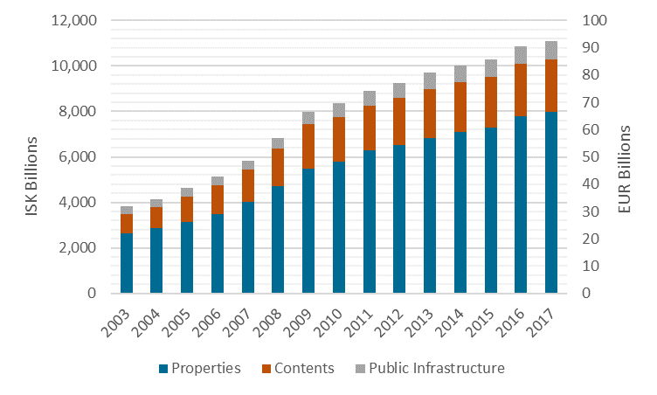
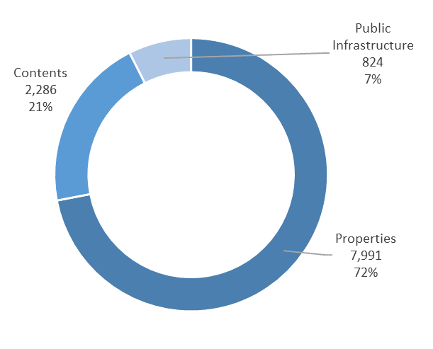
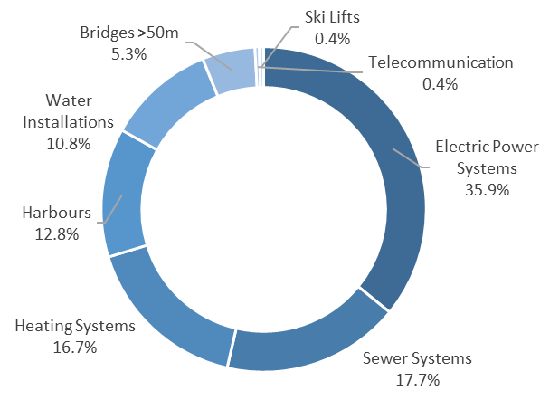
Sum Insured Aggregates 2017*¹
The assets that ICI covers against natural perils are located all over the country and are currently valued at ISK 11,101 billions (EUR 87.4 billions) compared to ISK 10,865 billions (EUR 85.6 billions), 12 months ago. This increase in value of 2.2 % is due to an appreciation of the Index of Building Costs.
The 2016 premium income for ICI was ISK 2,645 millions (EUR 20.8 millions). The premium income for 2017 is estimated to ISK 2,700 millions (EUR 21.3 millions).
Sum Insured Aggregates by Type*²
Public Infrastructure by Type
Aggregates
*¹ As at September 2017
*² Billion ISK

Slide 4
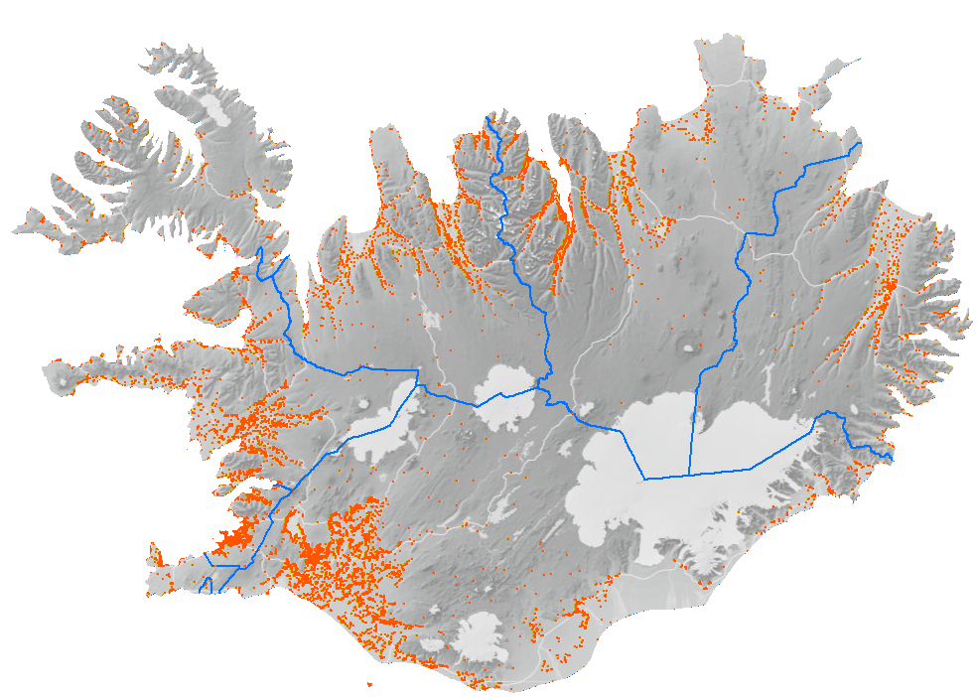
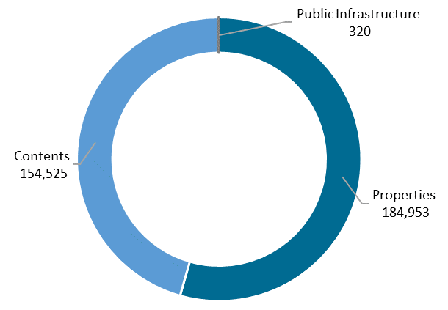
Aggregates by Region
Westfjords
North East
North West
East
West
Reykjavík
South
Reykjanes
Sum Insured Aggregates by Region and Type 2017*
Number of Policies
Aggregates
Region | Properties | Contents | Public Infra-structure | Total Billion ISK | Total Billion EUR
North East | 760 | 207 | 69 | 1,037 | 8.2
East | 286 | 105 | 26 | 417 | 3.3
South | 886 | 249 | 61 | 1,196 | 9.4
Reykjanes | 529 | 192 | 38 | 760 | 6.0
Reykjavík | 4,59 | 1,198 | 335 | 6,123 | 48.2
West | 454 | 119 | 17 | 590 | 4.6
West fjords | 204 | 52 | 17 | 274 | 2.2
North West | 239 | 69 | 13 | 321 | 2.5
El. Power and Bridges | 0 | 0 | 247 | 247 | 1.9
Various | 41 | 96 | 0 | 137 | 1.1
Total | 7,991 | 2,286 | 824 | 11,101 | 87.4
In total 339,798 Policies
*¹ As at September 2017

Slide 5
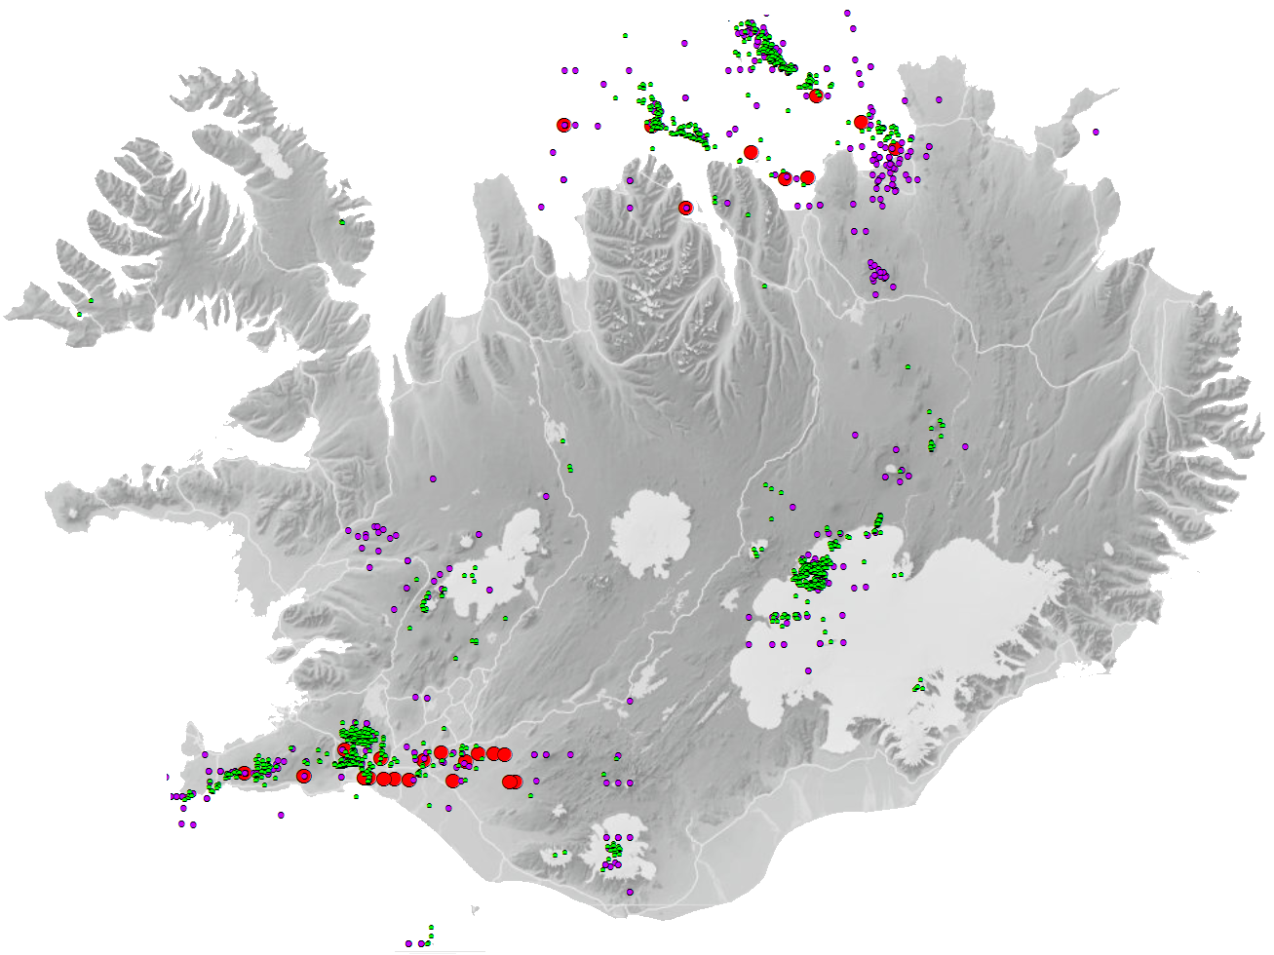
Natural Hazard
Although ICI offers and buys protection for a wide spectrum of natural perils including seismic and volcanic perils, the reinsurance protection has generally been geared around the earthquake hazard. For the last few years ICI has put an emphasis on assessing the volcanic risk in more detail. In 2018 ICI will work on the volcanic risk assessment in cooperation with local scientists and external experts.
Earthquake Hazard
The seismicity in Iceland is related to the Mid-Atlantic plate boundary which crosses the country. Within Iceland the boundary shifts eastwards in the south and back west in the north through two complex fracture zones. The southern zone, called the South Iceland Seismic Zone (SISZ), is located in the South Iceland lowland, whilst the other, the Tjörnes Fracture Zone (TFZ), lies mostly off the northern coast of Iceland. The largest earthquakes in the country have occurred within these zones. In the SISZ earthquakes tend to occur in sequences, which happen roughly every hundred years on the average. Such earthquakes take place when accumulated strain energy caused by tectonic plate movements is released. Since 1700 AD 16 earthquakes of magnitude greater than 6.0 (Ms) have occurred in the SISZ and 9 earthquakes in the TFZ. The maximum magnitude is estimated to be around 7.0 (Mw) for both zones. This upper bound is caused by relatively low rock strength and thin crust in the earthquake zones. Areas in both SISZ and TFZ with insured assets likely to be affected by major earthquakes share about 10 % of the total asset values in Iceland. Both are largely rural areas. In terms of percentages 10.5 % of the total asset values are located in the Southern Region. About 25 % of these are located in areas not likely to be affected by a major earthquake.
South Iceland covers the largest agricultural region in Iceland. Several small towns or villages, schools, medical centres, industrial plants, geothermal and hydropower plants and several major bridges are within this area.
The North East Region with about 30,000 inhabitants has a similar structure as the Southern Region and a share of 9.7 % of the total asset values. The principal town of Akureyri and surrounding rural area account for 65 % of these values and is not in the seismic area. There was a sizable earthquake in the North East in 1976 after the ICI was founded but damages were negligible.
M 3 – 4, 1991-2014
Perils
M 4 – 6, 1926-2014
M ≥6, 1706-2014
Recorded and historical earthquakes in Iceland. Green and purple dots show recorded earthquakes according to the catalogue provided by the Icelandic Met Office. Red dots show historical and recorded earthquakes M ≥ 6.0 back to the year 1706.

Slide 6
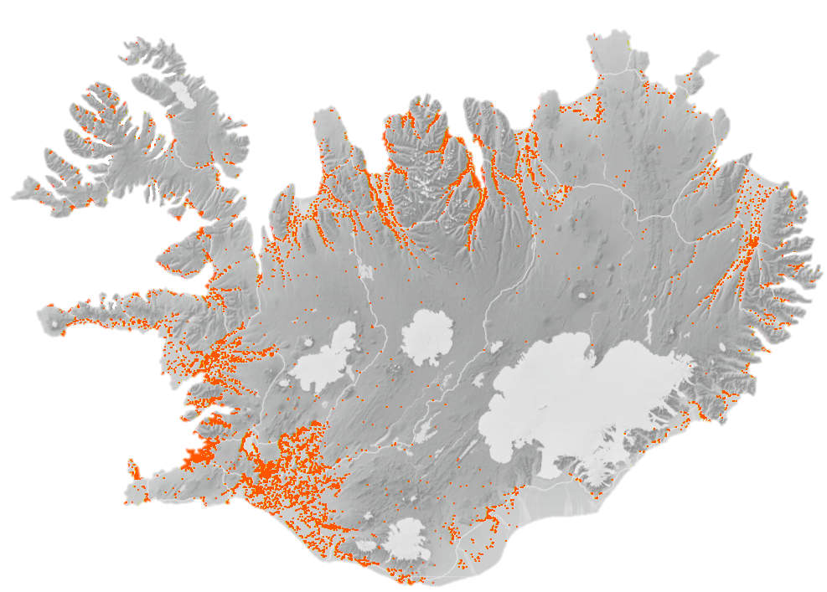
Volcanic Hazard
Volcanic eruptions are common in Iceland with individual volcanic events occurring every 3-4 years on average. The largest flood-basalt eruptions (> 10 km³) occur at a 500 – 1,000 year interval. Despite the dominance of basalts, explosive eruptions are more common than effusive, since frequent eruptions through glaciers give rise to phreatomagmatic activity. The largest explosive eruptions (Volcanic Explosivity Index - VEI 6) occur once or twice per millennium, while VEI 3 eruptions have recurrence time of 10 – 20 years. No evidence for VEI 7 or larger eruptions has been found in the geological history of Iceland.
Glacial floods, generally affecting the rural farm lands on the south coast of Iceland. From the 3 glaciers, Vatnajökull, Eyjafjallajökull and in particular Katla, could be the most threatening in this respect.
Downpour of tephra (ash fall) and fluorine poisoning of crops and livestock which is not insured by ICI. Again the south Iceland farmlands could be the most affected. Rural installations such as power stations, telecommunication lines and equipment, roads and bridges could be affected. The very fine tephra from Eyjafjallajökull 2010 and Grímsvötn 2011 was noticed in Reykjavík, more as an annoyance rather than calamity.
Major basaltic flood eruptions (similar to the Laki eruption in 1783 which had widespread effects all over Europe) would mainly be hazardous to power stations and communication lines.
Lava flows, especially true for the entire Reykjanes Peninsula with several small towns and the Keflavík International Airport at risk. Lava flows in Reykjavík last occurred in post glacial times.
Very large explosive eruptions (VEI≥6) in central volcanoes close to inhabited areas (for instance Öræfajökull 1362) might have serious effect on farms and villages. But no known active volcanoes are close to large urban centres in 2017.
Other Perils
Other perils such as floods and avalanches may cause isolated damage but it is unlikely that an event could exhaust the ICI’s own retention. ICI has used scenarios in order to assess the insurance risk related to these perils. An example of scenario exercise can be found in ICI’s Cat Response Plan, where 9 scenarios where analysed, including snow and mud avalanches in the East Fjords, and flood related to rockfall in the West Fjords.
ICI does not cover windstorms, bushfires or hale.
Scenario: Flood related to Rockfall
Perils
Scenario: Snow and Mud Avalanches

Slide 7

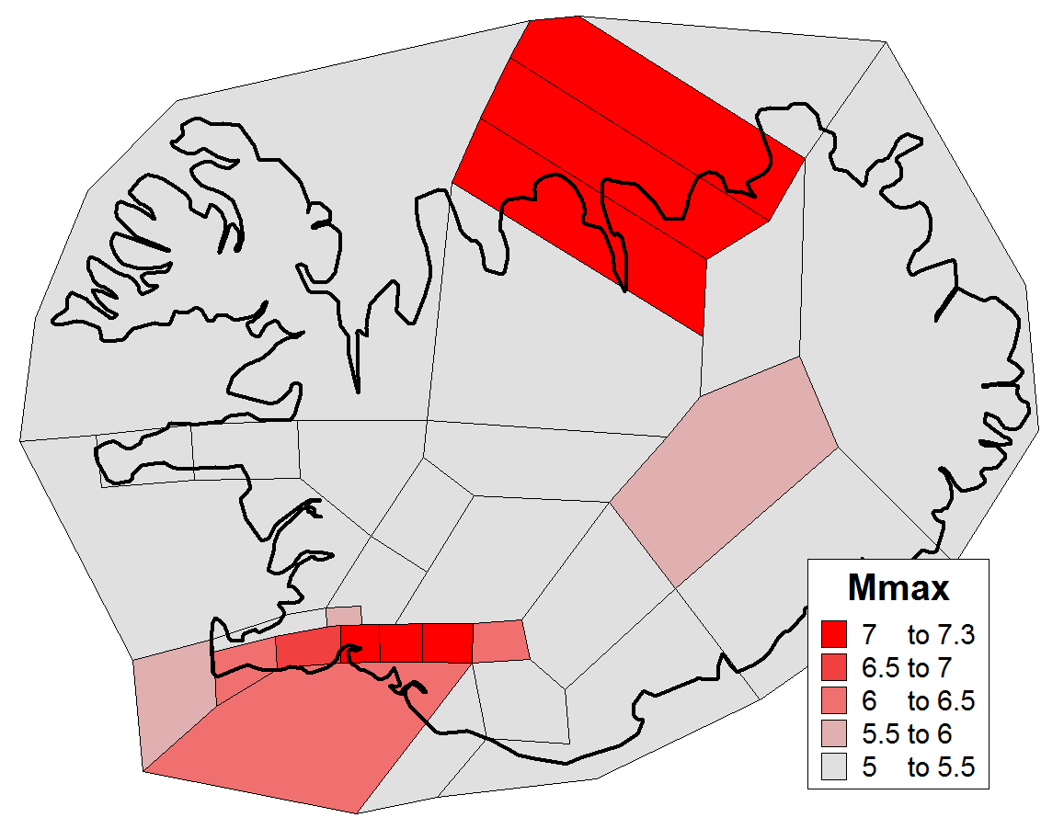
Risk Modelling
In the aftermath of the 2008 earthquake, which caused serious damage in the western part of the Southern Region, it was obvious that a major revision of the inherent earthquake risk and loss probabilities was required. It should be mentioned that after the 2008 earthquake as well as after the 2 destructive earthquakes in 2000 in the Southern Region, all damaged houses and facilities were inspected and the loss was evaluated by technical experts (engineers and surveyors). This has resulted in a unique database where detailed information about the buildings, year of construction, size, materials etc. and the damage incurred by the earthquakes have been compiled with nearly 5,000 entries. This database is of greater use when combined with the Land Registry Database. This is unique in the sense that all buildings in the country are registered in a common unified database with detailed description, GPS coordinates and replacement value, which is used (with depreciation factors for age and upkeep) as a basis for the compulsory fire insurance for the whole country. Furthermore, since the 1980’s an important series of PGA measurements has been collected. Upon that a great deal of work on the specific attenuation of earthquakes in Iceland has been based. This lead to the special attenuation formulae used in hazard maps for building codes and in the modelling of earthquakes.
Methodology
An extensive scientific data including bibliography with list of published papers and reports regarding seismicity, geology and geophysics in Iceland and a comprehensive catalogue of historical earthquakes were collected by experts at the University of Iceland and the Icelandic Met Office.
Hazard module was built by state-of-the-art techniques (Probabilistic Seismic Hazard Analysis) in cooperation with local scientists. All outputs were peer reviewed by external experts.
Exposure Data. The Land Registry (Iceland Registers) supplied the building database including detailed information of all buildings in Iceland.
All building types were classified into 19 descriptive classes. Detailed information of contents (values and geographical location) is also included in the model.
Vulnerability Functions (damage functions) were derived for the 19 building classes and for contents, by working with the collected data from the comprehensive damage surveys following the 2008 earthquake.
Finally a fully probabilistic model for Iceland based on the above components is used to compute the insurance risk. From 2014 the modelling has been performed in cooperation with Aon Benfield and Impact Forecasting.
In addition to the probabilistic modelling exercise ICI has developed a quick response deterministic model for specific events. This model allows to estimate major historical earthquakes and can also be used to verify by sampling the results of the probabilistic model. Furthermore it provides ICI’s reinsurers with more reasonable loss estimates following an event.
Risk
Seismic source zonation of Iceland and an estimation of maximum possible magnitude earthquakes. Dark red zones indicates the South Iceland Seismic Zone (SISZ) and the Tjörnes Fracture Zone (TFZ) in the North.

Slide 8
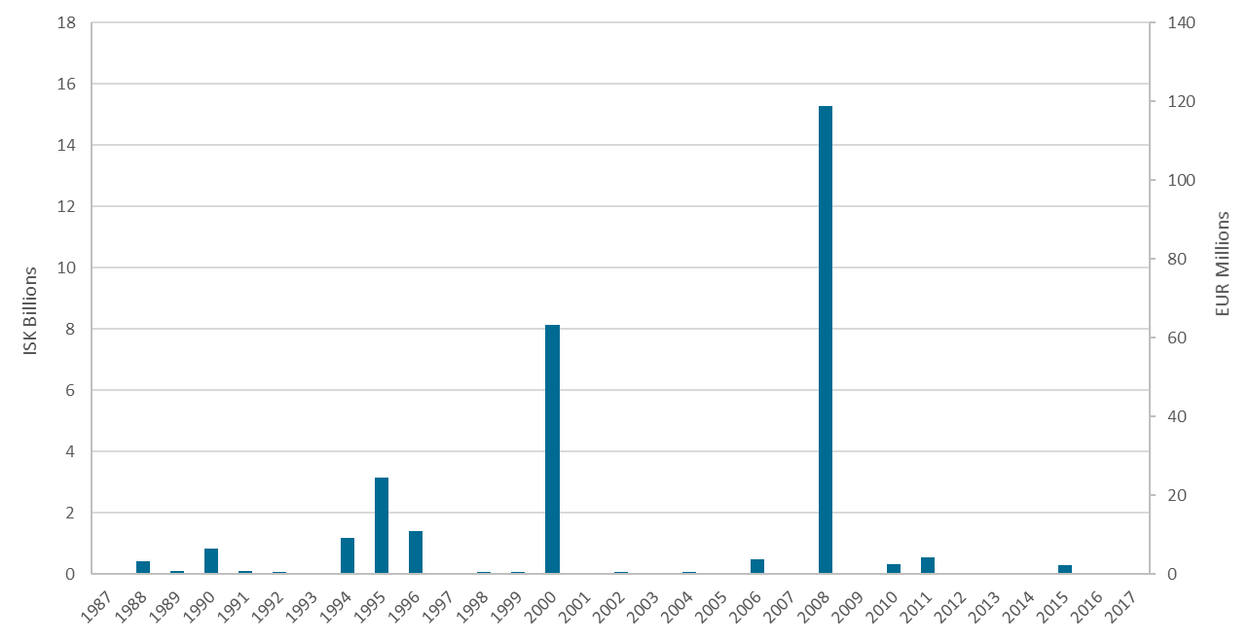
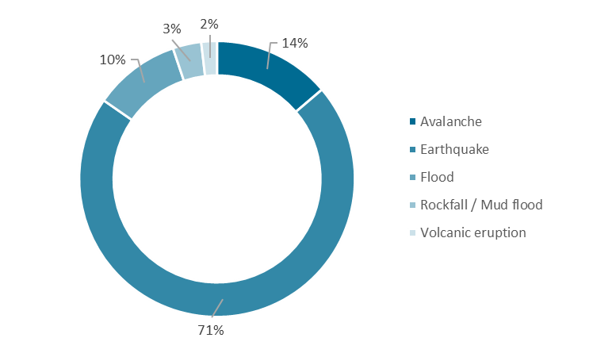
Loss History 1987-2017*
Losses 1987-2017 by Peril
About the Losses
From 1987 ICI has paid out losses from 232 events in total. Thereof 117 floods, 69 avalanches, 32 rockfall / mud floods, 12 earthquakes and two volcanic eruptions.
In 1995 villages and several farms in the West Fjords and the East Fjords were hit by avalanches. Total loss paid by ICI was about 3 billion ISK.
In 2000 two 6.5 Mw earthquakes shook South Iceland. Total loss paid out by ICI was about 8 billion ISK.
In 2008 ICI had its only reinsurance loss where the paid out loss was about 15.2 billion ISK, indexed according to the building cost as at September 2017.
Losses
All values are indexed according to Building Cost as at September 2017*
(1 EUR = 127 ISK)

Slide 9

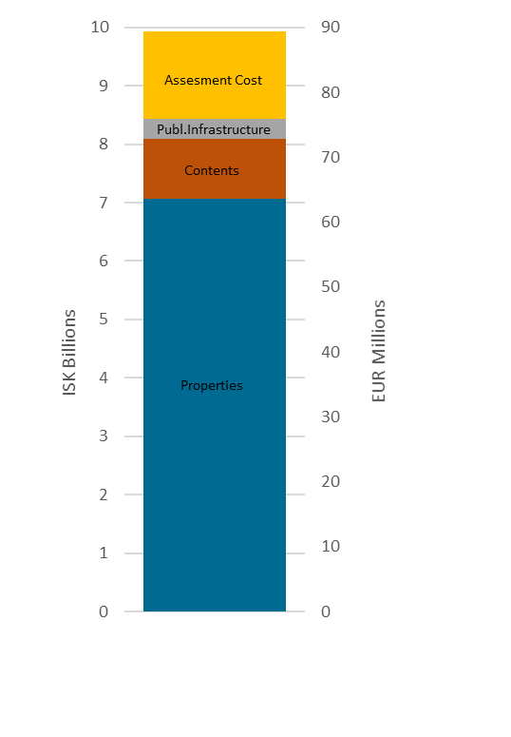
Major Historical Losses
In June 17th and 21st 2000, 2 earthquakes of magnitude 6.5 (Mw) happened in South Iceland. The surrounding area of both earthquakes is rural with the small village Hella (750 inhabitants) in about 12 km distance from the June 17th event epicentre and the town Selfoss (8,000 inhabitants) in about 15 km distance from the June 21st event epicentre. Despite the significant earthquake intensity no residential buildings collapsed. Only very few (less than 5) farm buildings but a considerable number of houses were damaged. However, claims following the 2 earthquakes in 2000 did not exhaust ICI’s own retention.
ICI’s only Reinsurance Loss
In May 29th 2008 a 6.3 (Mw) earthquake shook the western part of the South Iceland Seismic Zone (SISZ). The population in the affected area is currently about 18,500 inhabitants and there are approximately 6,000 residential houses, mostly low-rise buildings.
The 2008 earthquake caused serious damage to buildings in the rural area close to the epicentre and also in the two small towns Hveragerði and Selfoss, in about 4 respectively 7 km distance from the epicentre. Significantly less damage was observed in the small villages Eyrabakki and Stokkseyri and in the rural area in further distance from the epicentre.
The total paid out loss in the 2008 earthquake as at August 2017 ISK 9.95 billion with nearly 5,000 claims. The ICI reinsurance retention in 2008 was ISK 6.5 billion hence the reinsurance loss is ISK 3.45 billion. That was ICI’s only reinsurance claim since it was established in 1975.
Lesson learned
Since the earthquake in May 2008 ICI has constantly worked on improvements of the most important processes. Both probabilistic and deterministic seismic risk models have been launched. A catastrophe response plan was introduced in 2014. Significant improvements have been made regarding quality management and the entire claim management process.
Ultimate Net Loss
Losses
 | 2008 | 2009 | 2010 | 2011 | 2012 | 2013 | 2014 | 2015 | 2016 | 2017* | Total
Properties | 3,620 | 2,600 | 448 | 147 | 129 | 27 | 24 | 18 | 24 | 28 | 7,065
Contents | 943 | 55 | 28 | 2 | 2 | 0 | 0 | 0 | 0 | 0 | 1,030
Public Infrastr. | 10 | 132 | 186 | 0 | 1 | 0 | 14 | 0 | 0 | 0 | 343
Assessment cost | 588 | 526 | 129 | 48 | 60 | 47 | 44 | 21 | 17 | 14 | 1,495
Total | 5,161 | 3,314 | 792 | 197 | 193 | 74 | 82 | 39 | 42 | 42 | 9,934
Values are not indexed
* As at August 2017

Slide 10
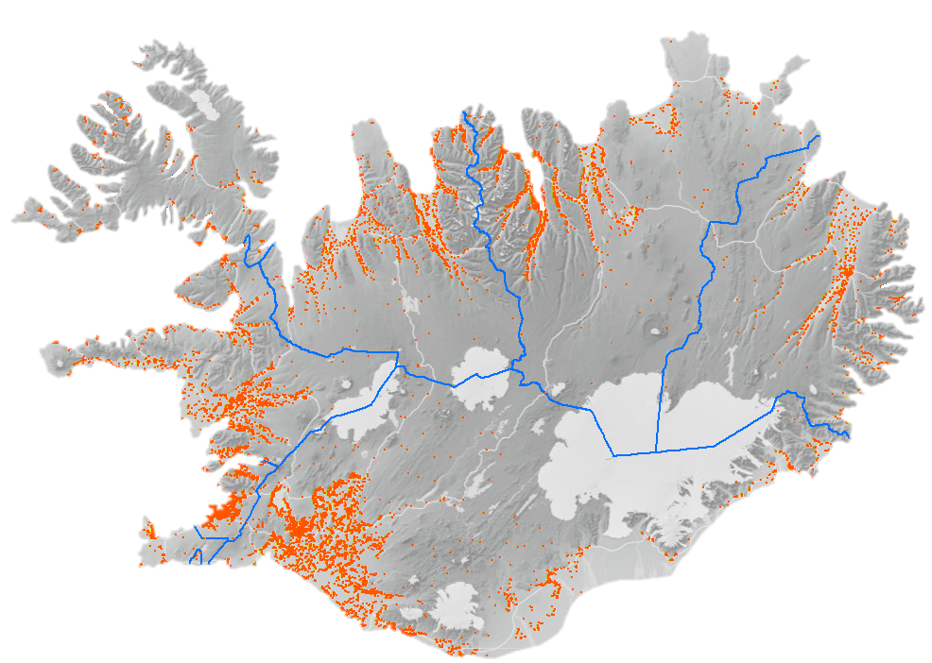
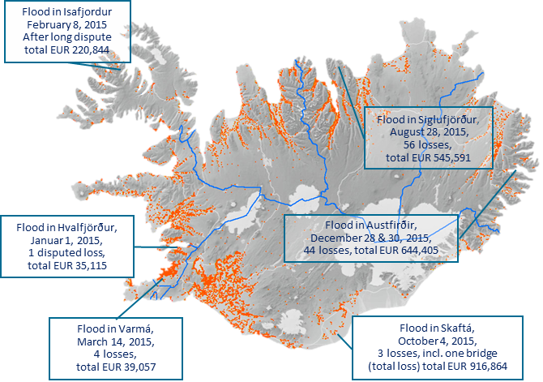
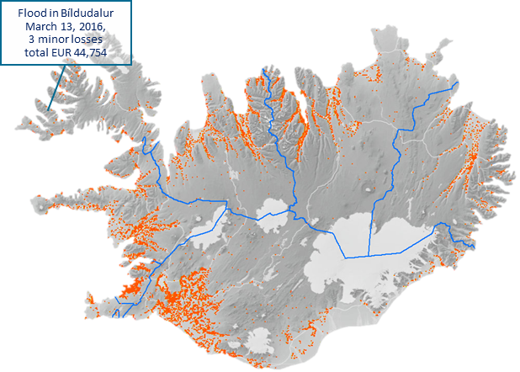
Loss Events from 2014 - 2017
2014
2015
  Mud Avalanche in Kinn
  June 4, 2014
  1 loss,
  total EUR 26,408
  Flood in Reykjanesbær
  January 7, 2014
  1 loss, total EUR 4,430
2016
2017*¹
Losses
  Mud Avalanche in Austfirðir,
  June 24, 2017
  8 losses, total EUR 101.403
  Flood in Austfirðir,
  June 23, 2017
  22 losses, total EUR 142,657
  Flood in Steinavötn
  February 15, 2017
  1 loss, total EUR 5,763
*¹ until end of August 2017
All amounts are based on the exchange rate as at September 2017

Slide 11

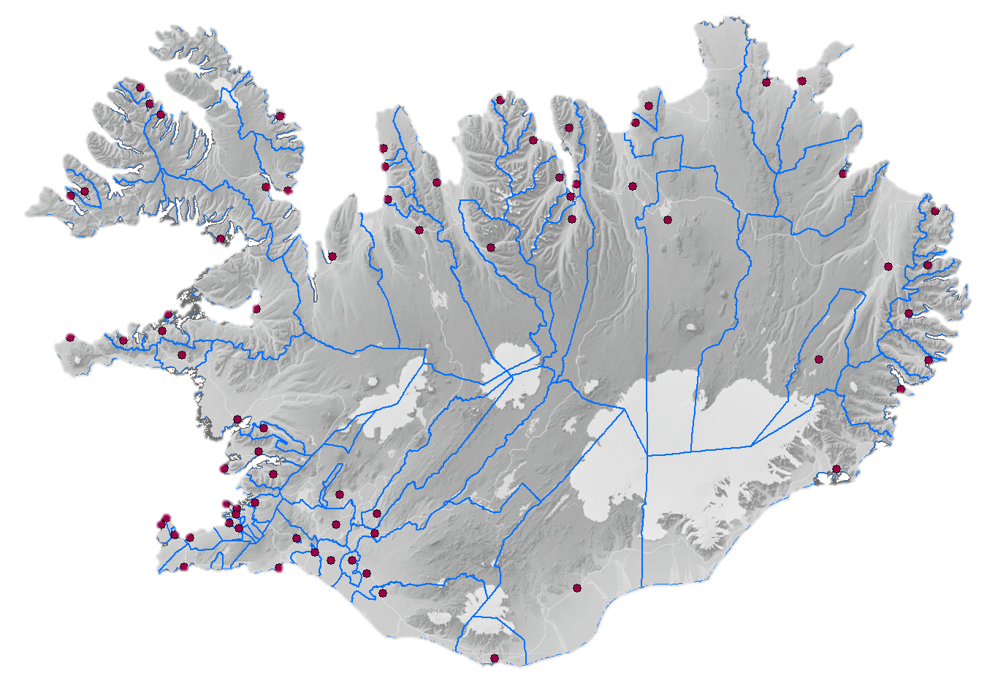
For the Common Good of the Community
When nature is quiet every moment is used for improvements and preparation for future catastrophic events. Looking back at ICI's foundation its obvious purpose was to assure communities' capabilities to surpass events like the volcanic eruption in Vestmannaeyjar in 1973. At the time of the eruption the community was unable to operate without financial intervention from the Icelandic government. The volcanic eruption in 1973, followed by a snow avalanche in the East Fjords in 1974, had a huge impact on the government to found ICI in 1975. Since then it has been mandatory for all Icelandic municipalities to insure their most important infrastructures against natural catastrophes.
There are 74 municipalities in Iceland, a 103,000 km² country. The population in each municipality ranges from 53 to 125,000 with 7 villages having fewer than 100 inhabitants. Since the same rules apply to all municipalities some municipalities face a heavy burden when it comes to public utility service. Since ICI is governmentally owned it is socially responsible to draw attention to the importance of having all infrastructure covered in full, in case of future catastrophic events. In the last decades ICI sent letters and emails to remind people of this important precautionary action without any real success. Replacement costs of public infrastructure were indexed routinely from year to year with very few municipalities ever reporting changes or developments to their infrastructures.
From November 2016 to April 2017, ICI travelled around Iceland to visit all municipalities and advise them on reporting developments to ICI to insure proper insurance cover of all their assets. A total of 60 meetings were held with roughly 180 participants, about 7,000 km were travelled and 36 working days used in this project. The map below shows each meeting place.
As a result, ICI sees an increase in insured values and number of insured public infrastructures including sewer systems and fibre cables. Most importantly, ICI has set out a clear message: Uninsured assets will not be compensated for, neither by ICI nor the government.
Management

Slide 12




New Regulation
The earthquake 2008 was a great stress test for ICI’s law and regulations. Following the claim settlements ICI has pointed out some important improvements related to both existing act from 1992 and the regulation from 1993.
A new regulation on ICI no 642/2017 was passed in July 2017. The changes in regulation have minor if any impact on reinsurers at all, but are supposed to improve, and strengthen the claim process on behalf of ICI.
An example of improvements is a more precise definition of perils in order to clearly describe ICI’s responsibility and avoid unnecessary disputes.
Based on the experience of lack of information on behalf of the municipalities it is now clarified that the responsibility for calculating and maintaining accurate replacement costs of public infrastructure is placed on their owners. It was also clarified that the index to be used is the “Building Cost Index” for extrapolating replacement costs for public infrastructures.
How we ensure Resilience
Quality Management System
In order to ensure business continuity ICI haa heavily improved its methods and processes since the 2008 earthquake. A Quality Management System that is in compliance with the ISO 9001 quality standard has been implemented. Implementation of this quality system began in October 2011 with the board's approval of a quality policy which aimed to implement the current quality system. In June 2013 the quality system gained certification in compliance with the ISO 9001 quality standards by the British Standard Institution. The quality system increases the reliability of data, storage, traceability and consistency of procedures. It also improves ICI’s business continuity in a broad sense.
Cat Response Plan
In May 2014 ICI launched a Cat Response Plan (CRP) in its first edition. The CRP is based on nine scenarios of different events; 3 earthquake events, 3 volcanic eruptions, a tsunami event, a glacial flood, an avalanche and a mud flood. This CRP includes work processes, checklists and other resources to ensure swift, accurate and appropriate responses following catastrophic events. The CRP contains instructions regarding reporting to stakeholders and various quality documents to ensure that responses are consistent and reliable.
In preparing the CRP the importance of active cooperation of management and employees was emphasized. The implementation has had clear benefits and has been proven successful in tests as well as in smaller-scale events where decisions regarding activation of the CRP and reporting information to stakeholders were taken immediately following an event and in some cases when an event was imminent.
Claims Management System
In 2015 ICI reported on a new Claims Management System (CMS) which was fully implemented in the early months of 2015 and has since then improved employees‘ time efficency in claims handling. The CMS has detailed reporting capabilities that will be used to provide accurate information flow to reinsurers during all stages of claim handling, including numbers of claims and estimated values of claims for any event.
Management

Slide 13

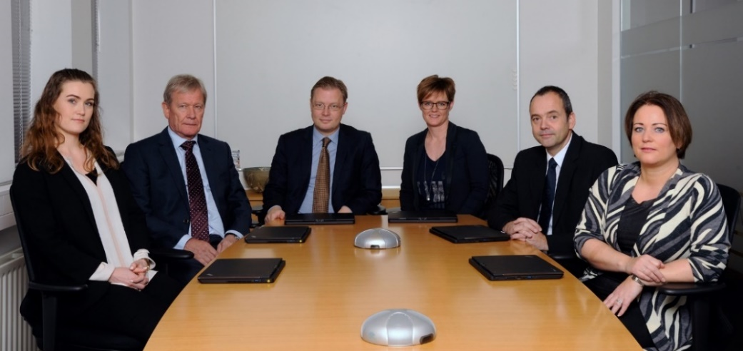
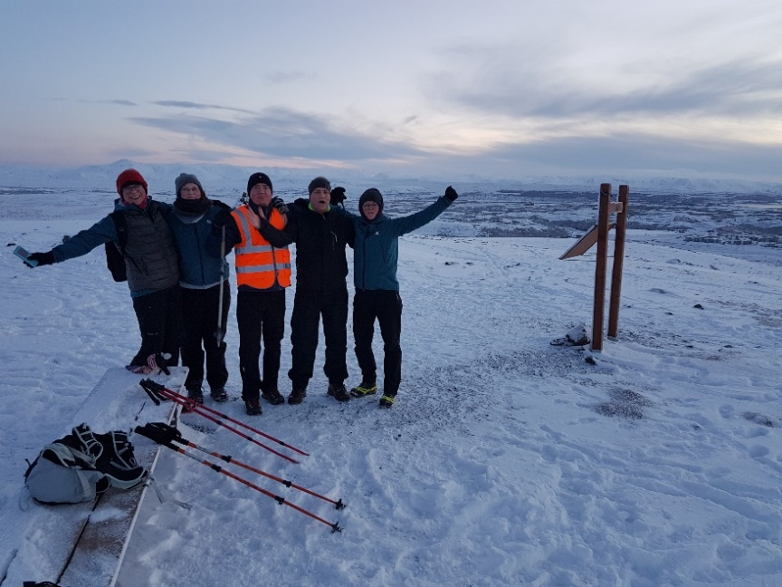
Board of Directors
ICI‘s board of directors is comprised of 5 members that are appointed for 4 years at a time. 3 members are appointed by the Icelandic Parliament, one by the Icelandic Financial Services Associations and one by the Minister of Finance and Economic Affairs. The board of directors 2015-2019 (from left): Vigdís Halldórsdóttir, Adolf Guðmundsson, Sigurður Kári Kristjánsson (Chairman of the Board), Ragnar Þorsteinsson and Lína Björg Tryggvadóttir. All board members have kjkljkjjkjkj.
substantial professional experience and hold university degrees in either law or business administration. The CEO, Hulda Ragnheiður Árnadóttir (center right) is recruited by the board of directors. She holds a M.Sc. Degree in banking, finance and multinational business as well as diplomas in good governance, public administration and management. Prior to joining ICI in 2010 Hulda was an internal auditor at Arion Bank.
Teamwork
The staff at ICI‘s office is a group of energetic and enthusiastic people. All have their specialities, but the team shares know-ledge and projects to ensure everything is done timely and in the best possible quality.
The picture on the left was taken in January this year, at one of ICI's mountain team tours where they spent some time after work with a pleasant workout in the beautiful nature of Iceland.
From the left you see Jonina, the accountant. She is responsible for loss information. In the past two years she has been working hard on collecting information about losses 30 years back in time. Next is Tinna, the quality manager and treasurer. She makes sure all procedures are up to date and takes good care of all payments to ICI' claimants. Jon Orvar is well known by most of ICI's reinsurers. He is the risk and modelling analyst. Halldor is ICI‘s lawyer and responsible for preparing disputed claims and negotiations with claimants. On the right side is Hulda, ICI‘s CEO.
Management
She is responsible for daily operations at ICI. Furthermore she is the one who is responsible for handling claims , from single claims to catastrophic events. Having this great team on her side, she is sure that ICI will succed in any upcoming operations.

